Slide 1
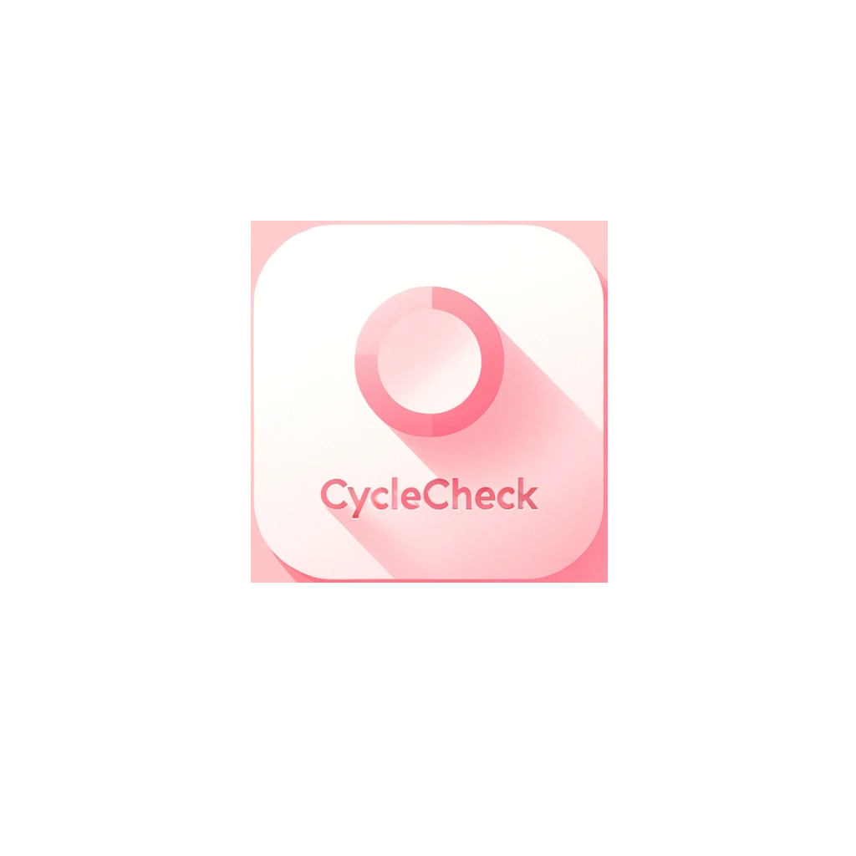
-Body Temperature Tracking System to Predict menstrual cycles and Pregnancy
CycleCheck: Menstrual Cycle Monitoring App
Xiaoqiao Zhang
Student ID: 885865576
Advisor: Dr.Christopher Ryu
Reviewer: Dr. Kenneth Kung
CPSC 597

Slide 2
Introduction
Introduce
Background
How System Work
Feature
Development environment
Benefits
Challenges Faced & Solution
Conclusion

Slide 3
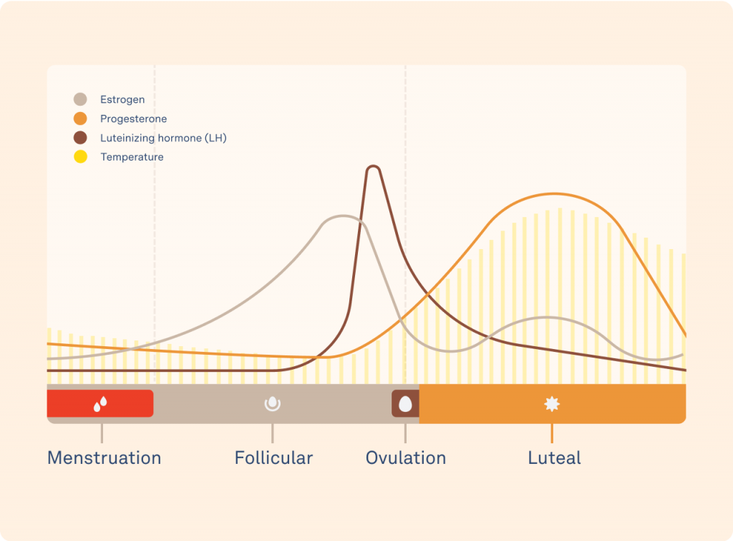
Background
Tracking body temperature to predict menstrual cycles and ovulation has been used for decades to help families plan and prevent or promote pregnancy.
Software and apps are now available that can track temperature data and predict menstrual cycles, but there is still room for improvement in the algorithms used to detect pregnancy.

Slide 4
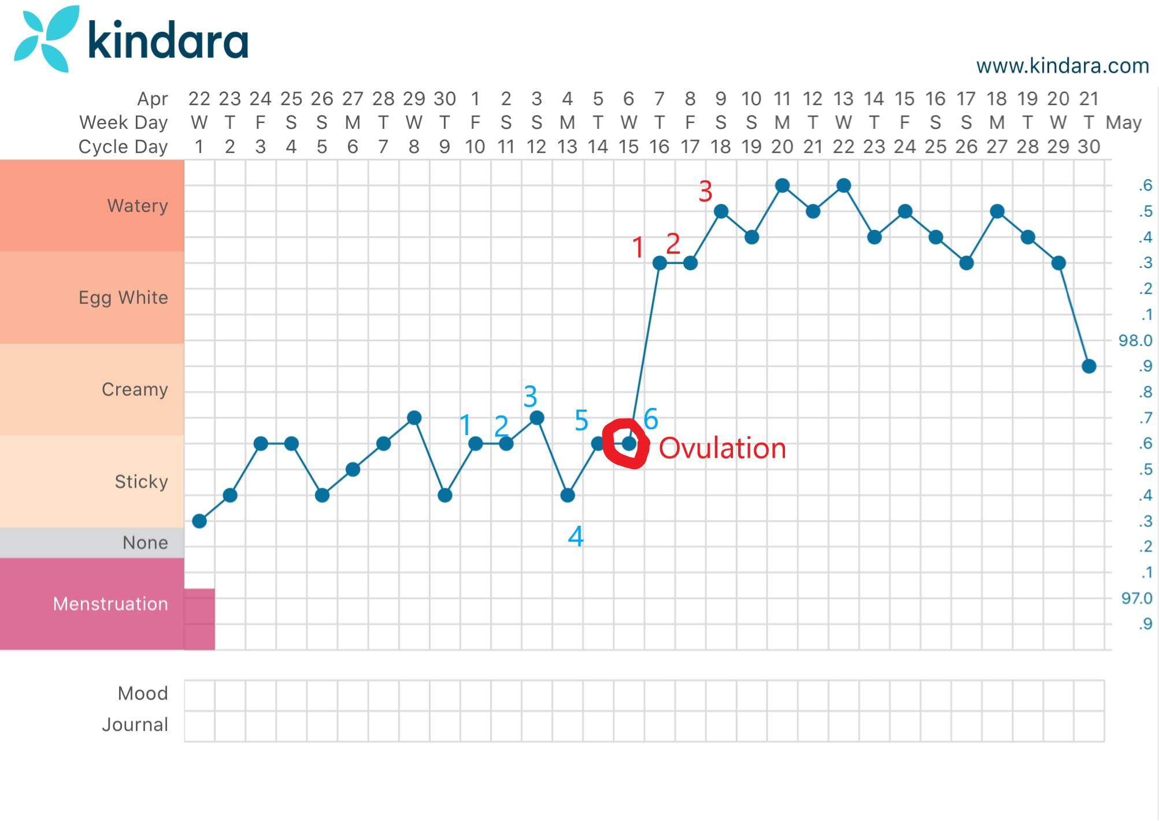
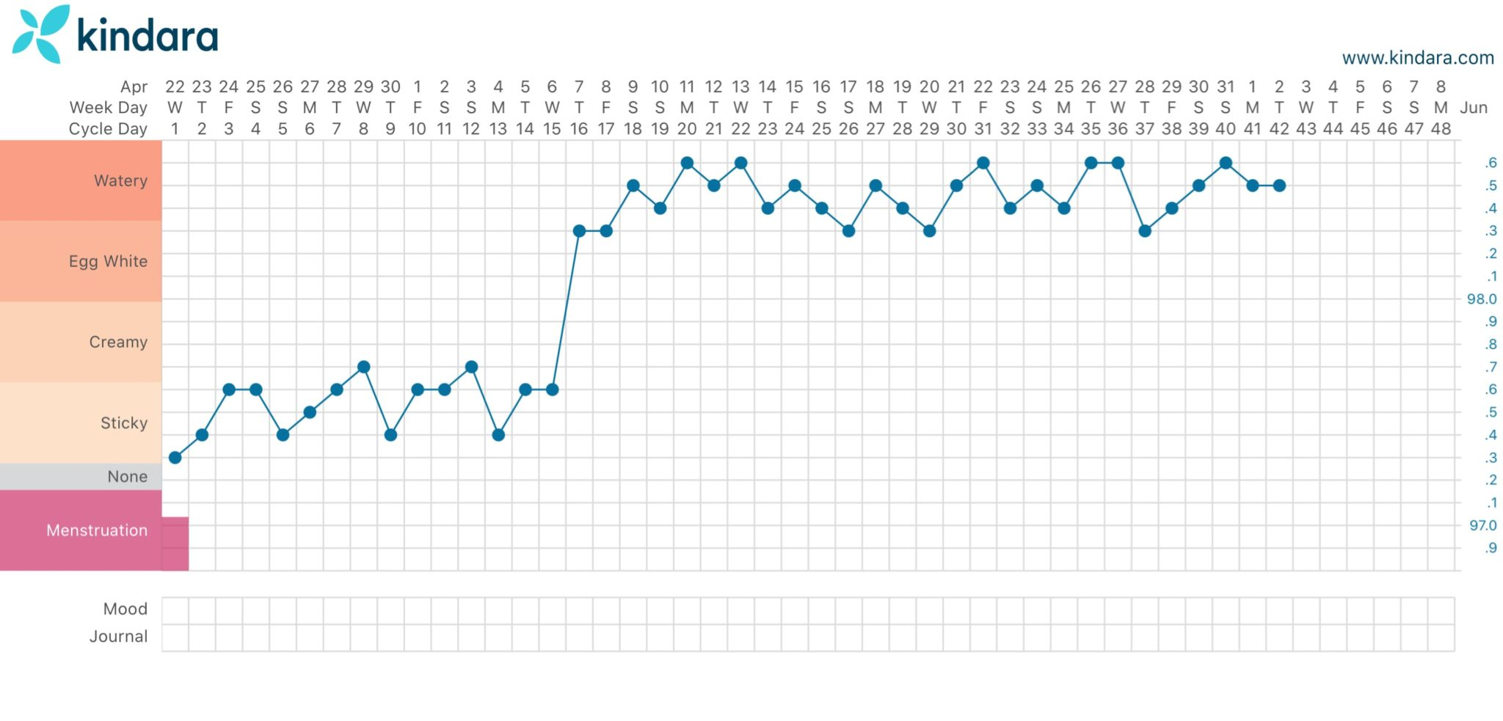
Background
-Your basal body temperature is your temperature when you're fully at rest.
-Ovulation may cause a slight increase in basal body temperature.
-By tracking your basal body temperature each day, you may be able to predict when you'll ovulate.

Slide 5
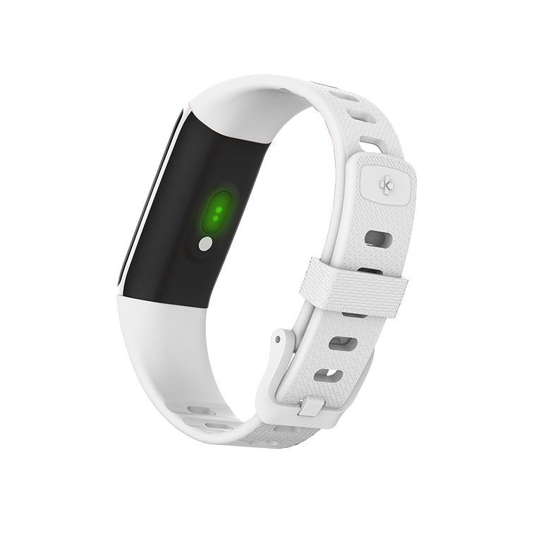
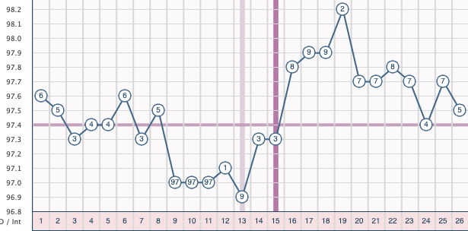

How System Work

Slide 6
Benefits
Tracking body temperature can help women understand their menstrual cycles and predict ovulation with greater accuracy.
This can help women plan and prevent or promote pregnancy, leading to better family planning and reproductive health.
Wearable devices and mobile apps have made tracking body temperature more convenient and accessible for women, but accuracy of the data is crucial for reliable predictions.

Slide 7

Benefits
With the increasing restrictions on abortion access through heartbeat bills, accurate tracking of menstrual cycles and pregnancy detection is more important than ever for women's reproductive health and autonomy.
By tracking their body temperature and other fertility signs, women can detect pregnancy sooner and make more informed decisions about their reproductive health, even within the shortened time frames imposed by heartbeat bills.

Slide 8
Development environment
React Native (expo)
Node.js(Backend)
Firebase (Database)
VScode
Git and Github (Version control system)

Slide 9
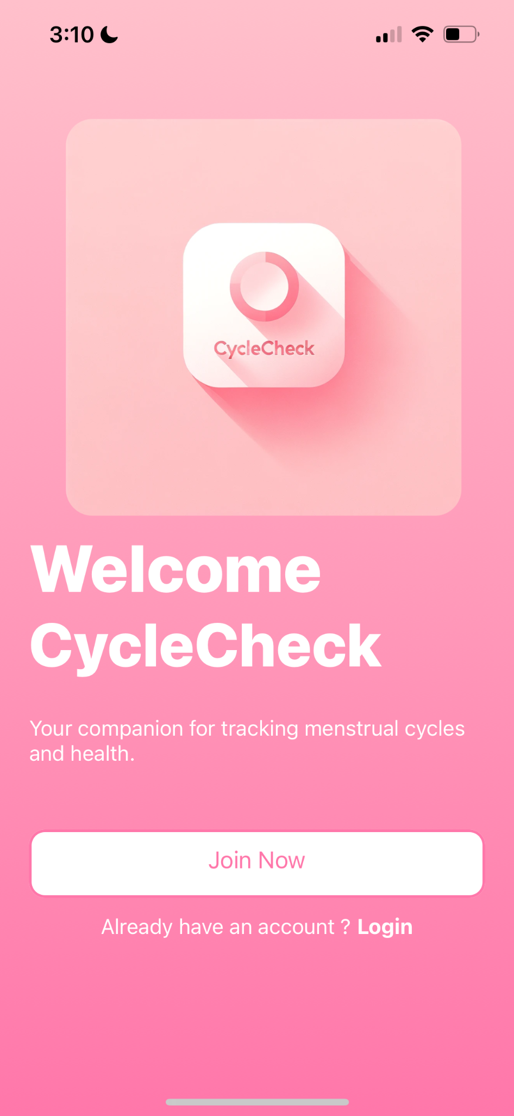
Feature
Welcome Page

Slide 10
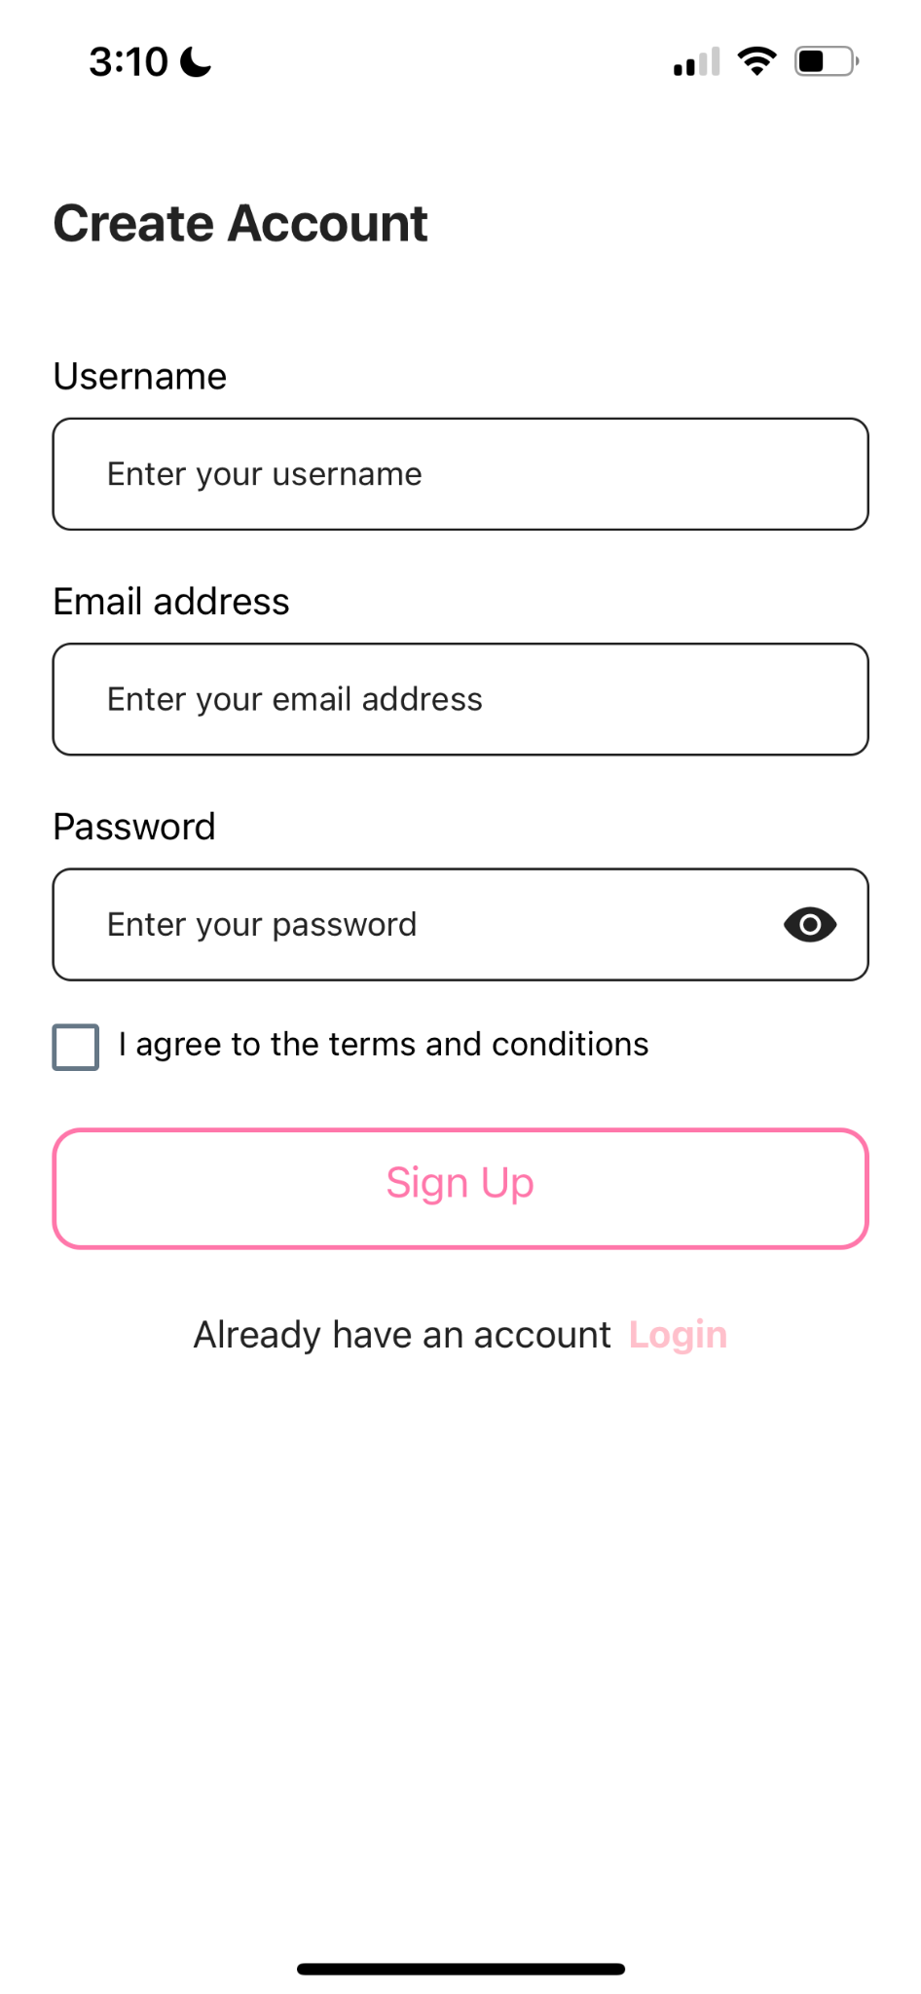
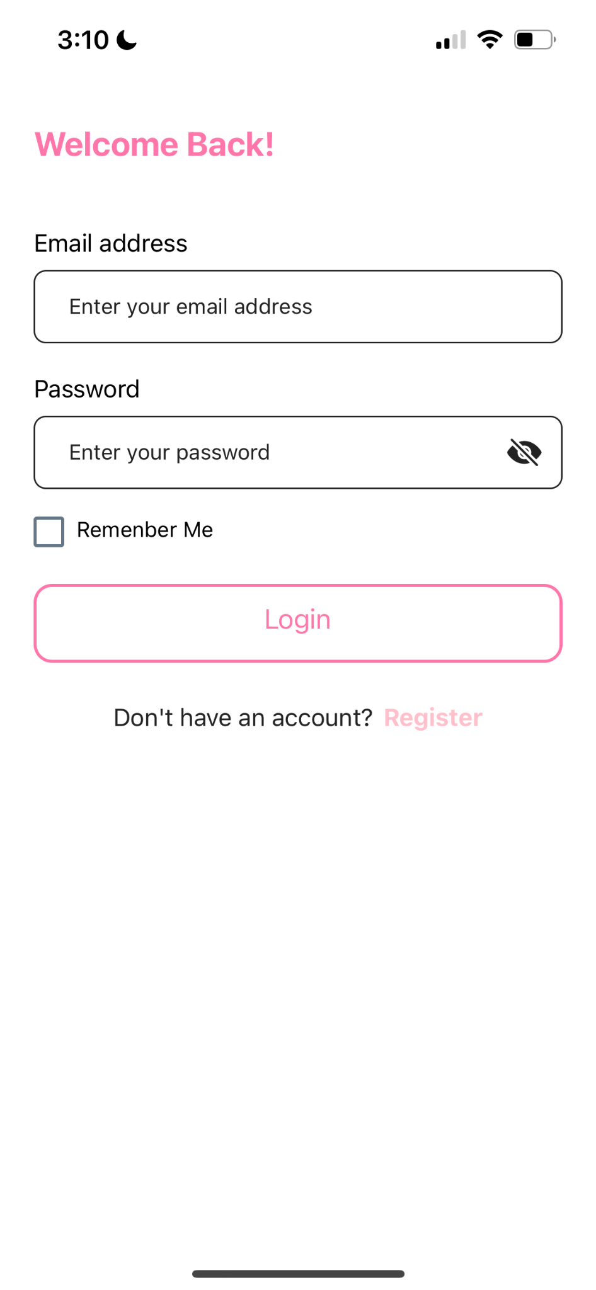
Feature
Login/Sign up:
Email and Password.

Slide 11
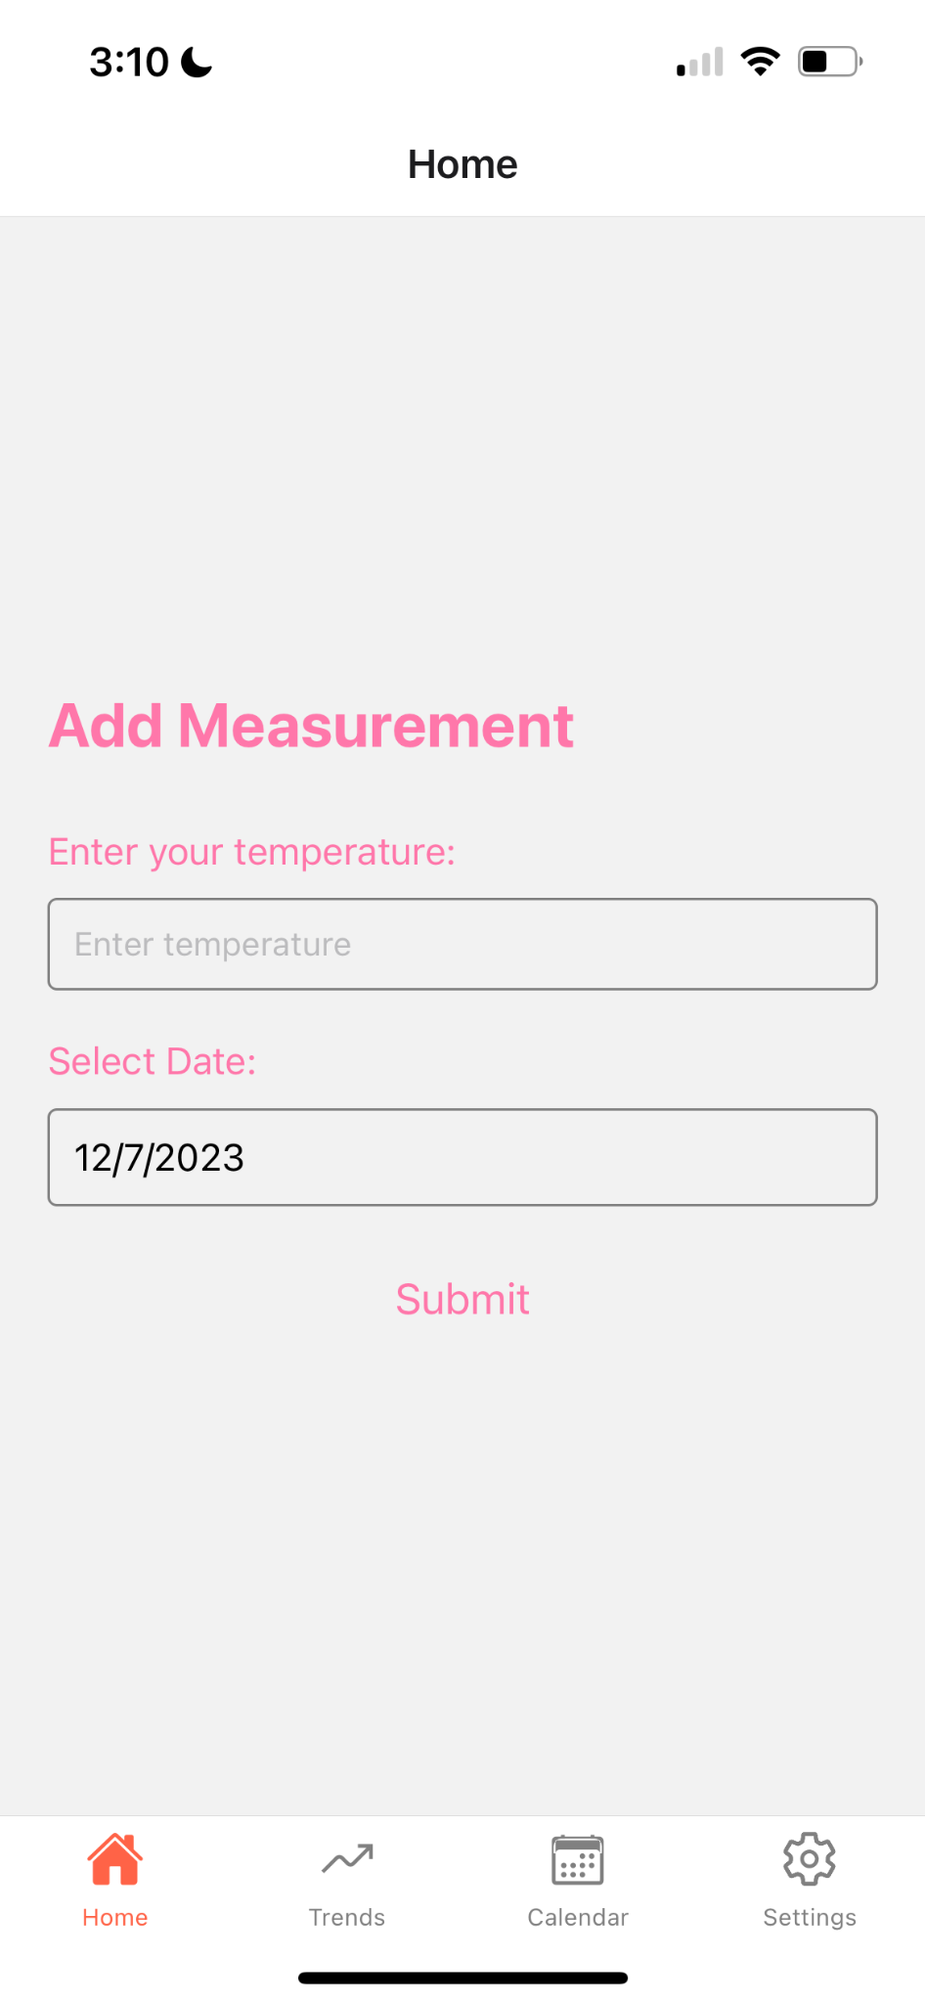
Feature
Home Page :
Add Temperature

Slide 12
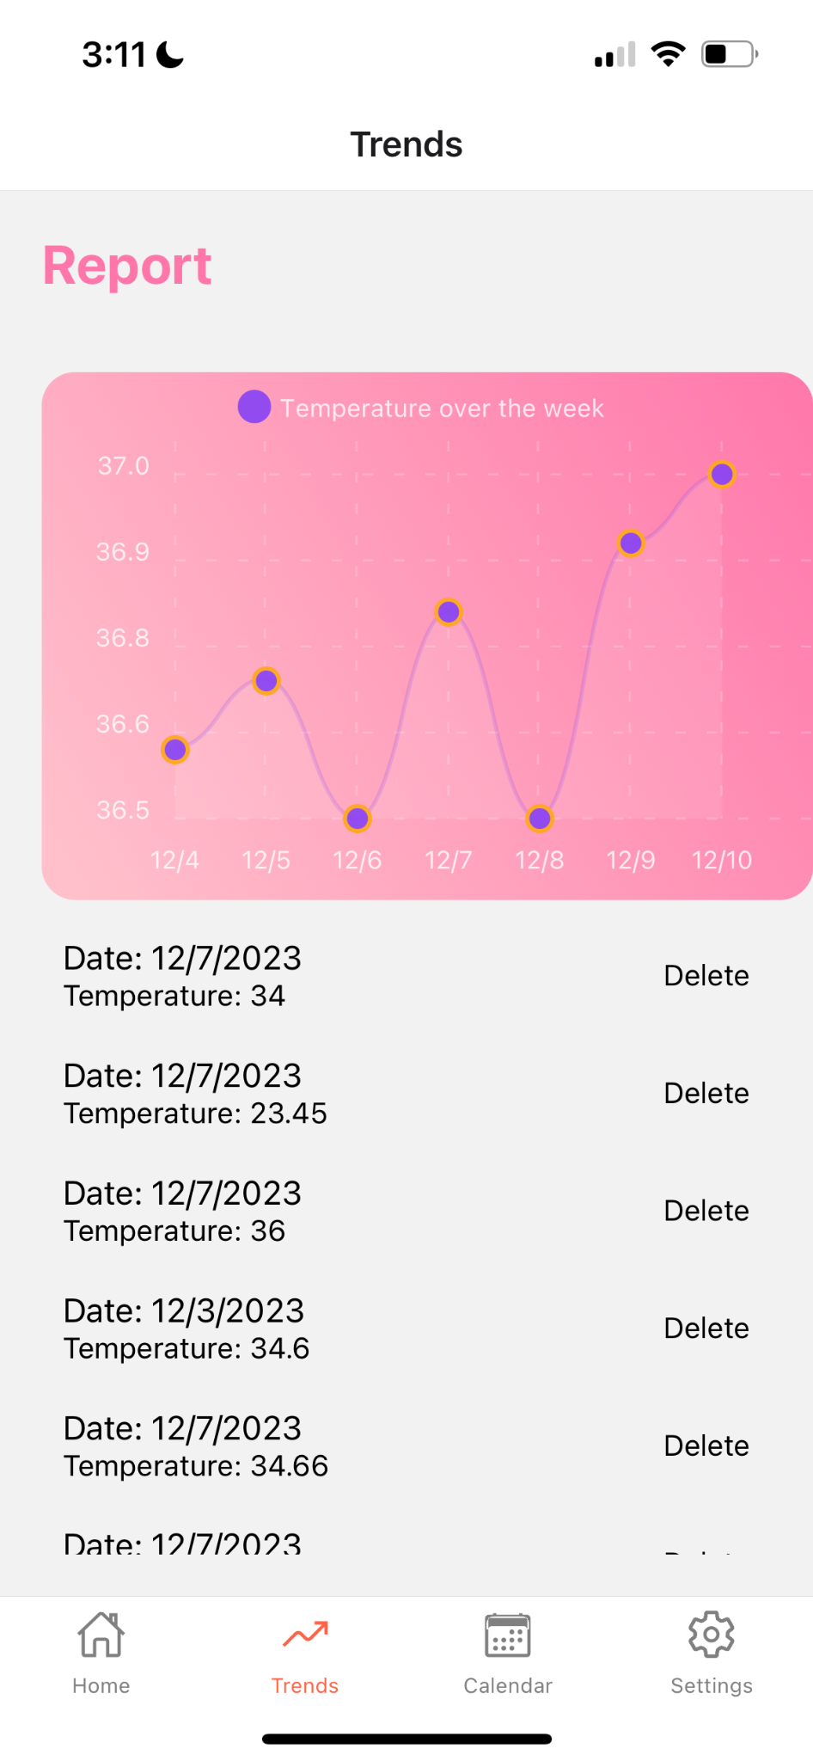
Feature
Trends

Slide 13
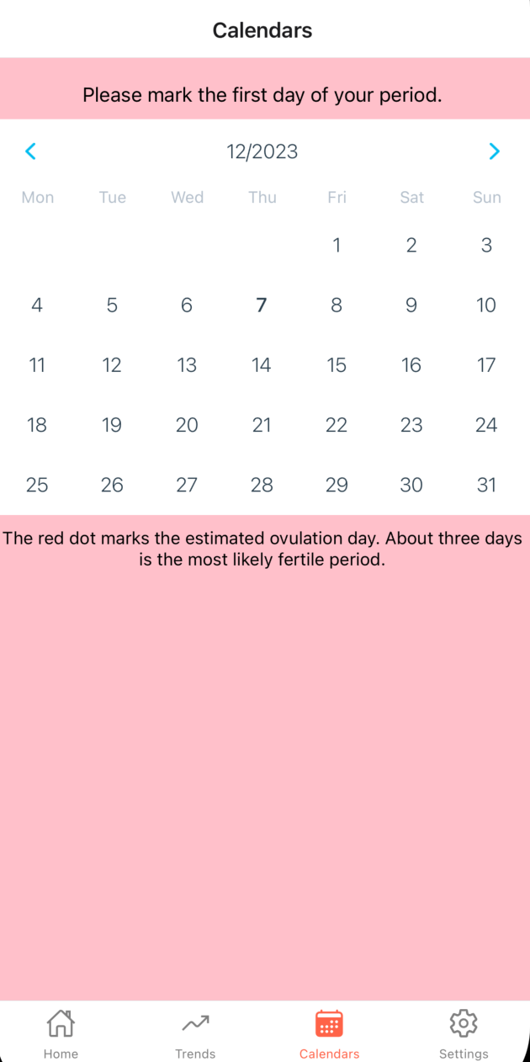
Feature
Calendar

Slide 14
Challenges Faced & Solution
Interpretation of temperature data:
Temperature data can be affected by many factors: weather, stress, illness,and medication use.
Need to exclude interference factors for accurate analysis
Solution:
Suggest user wear devices 24 hr.
Also provide the calendar to calculate the ovulation day by the period cycle.

Slide 15
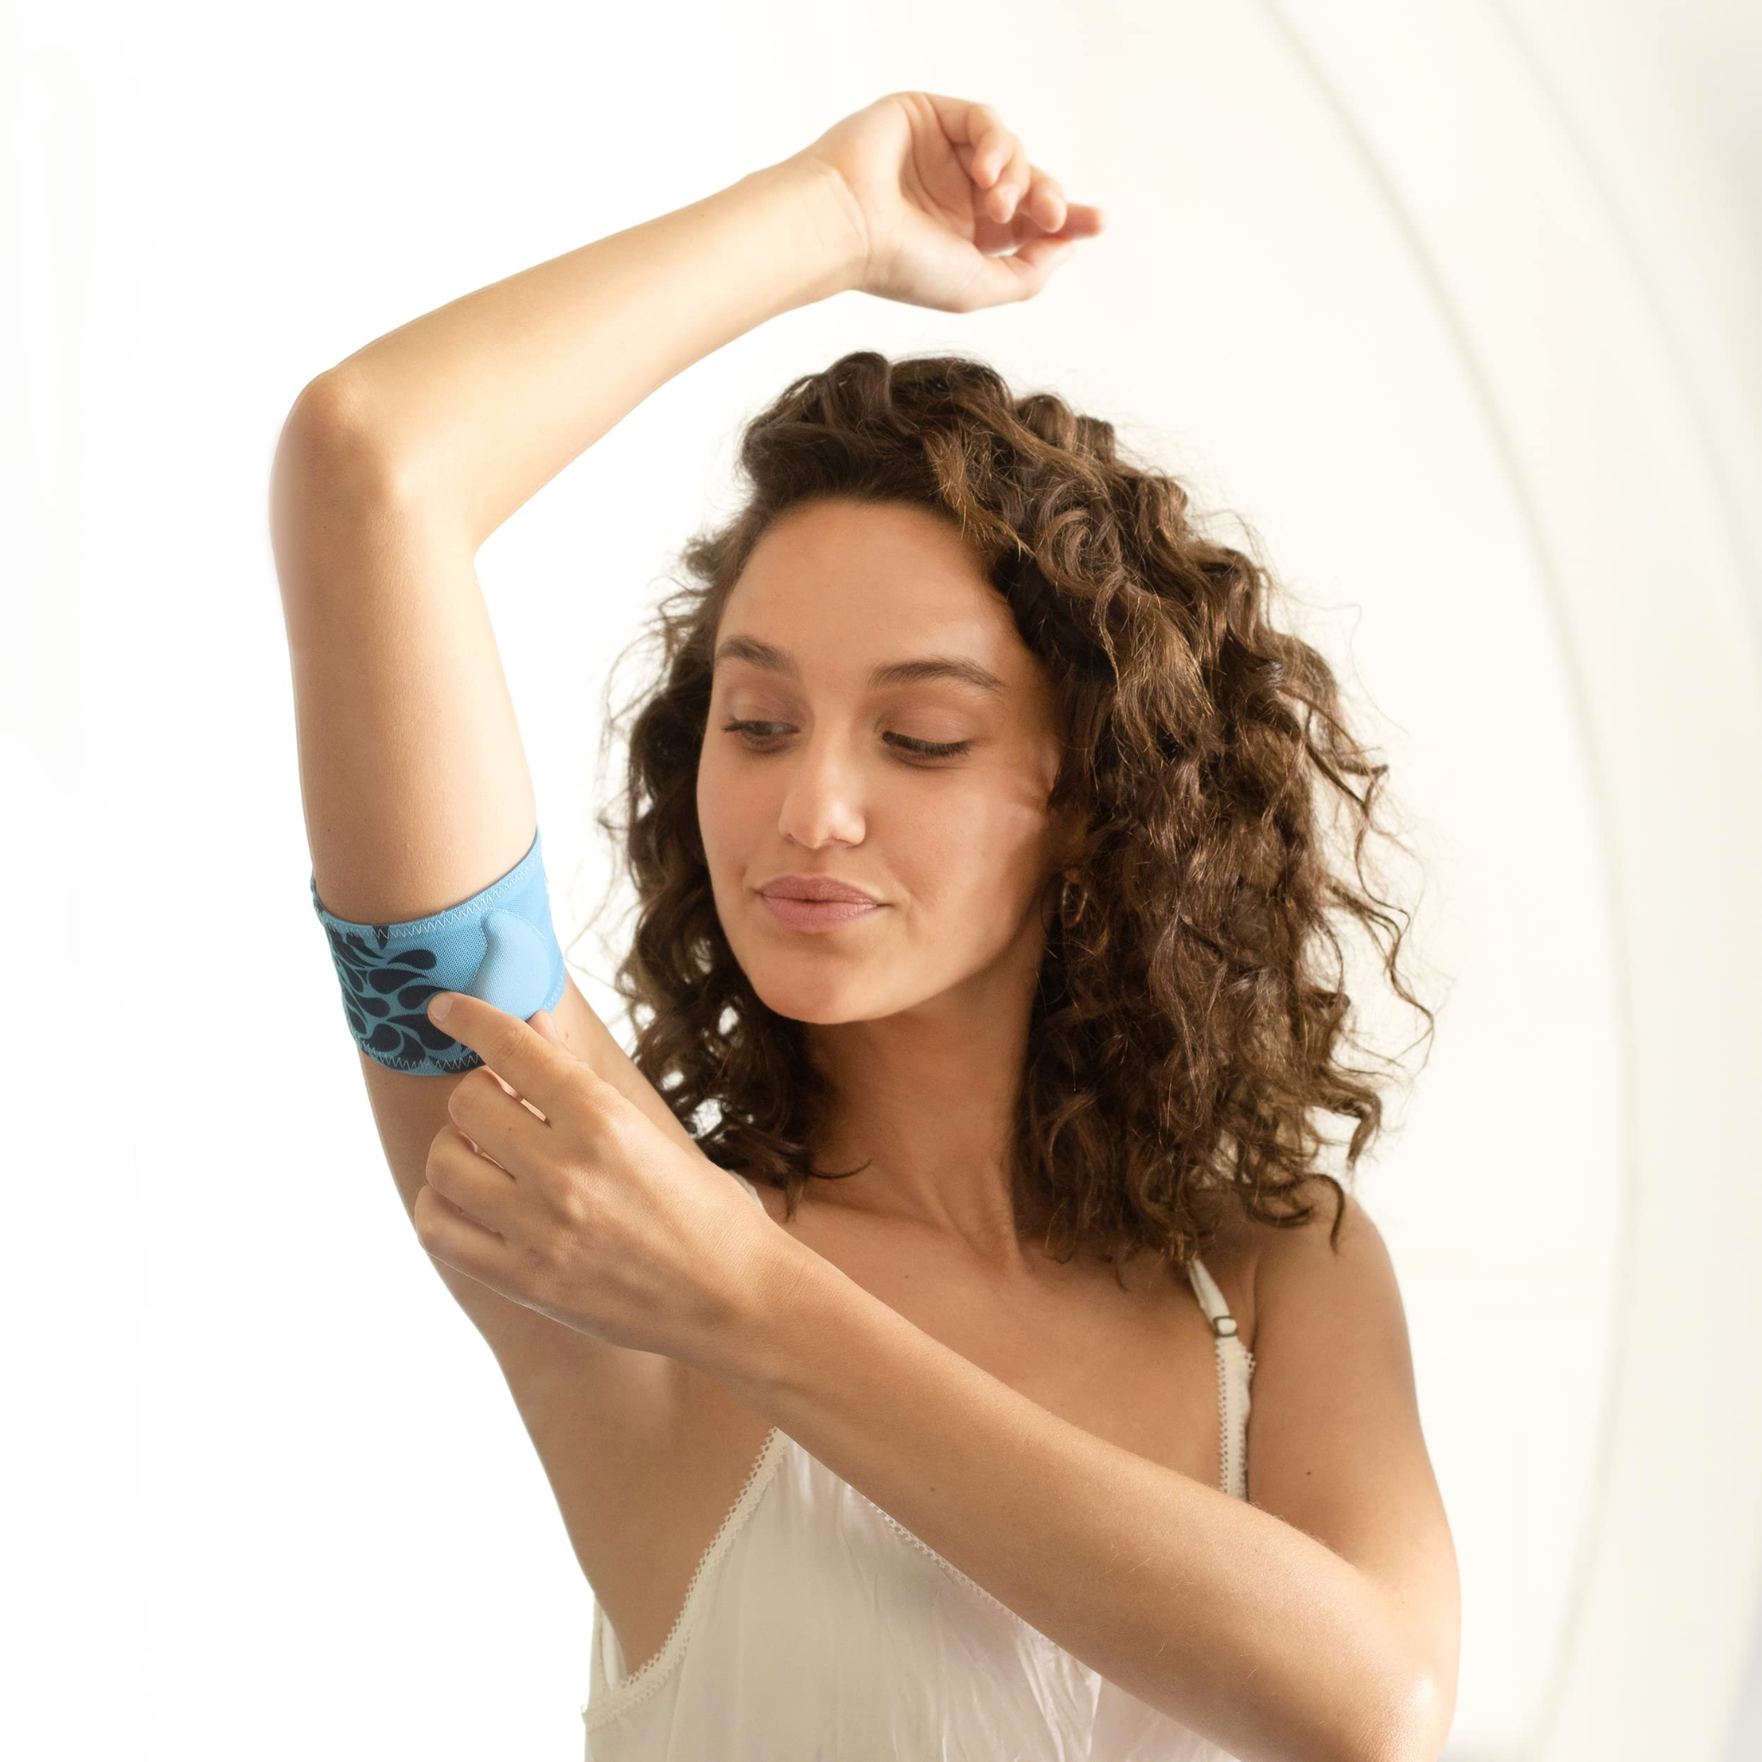
Challenges Faced & Solution
Hardware equipment support:
Certain hardware support is required for accurate data collection
Solution :
Professional band
Focu on the trend Chat, not single data.

Slide 16
Challenges Faced & Solution
Learning curve for new technologies.
Trouble with import data

Slide 17

Challenges Faced & Solution
Legal Issue:
For more accurate results, people need to consult a doctor or healthcare provider.

Slide 18
Conclusion
Recap of CycleCheck: CycleCheck used technology to help people with a user-friendly and reliable way to monitor their menstrual cycle and predict ovulation.
Impact: By providing accurate tracking and predictions, CycleCheck aims to improve the daily health management and well-being of its users.
Future Vision: Looking forward, we are committed to continuous improvement and innovation, including potential integrations with health wearables and advanced prediction algorithms.

Slide 19
Thank you!
Question?
Demo time!

Slide 20
Reference
https://www.jafariacupuncture.com/bbt-charting-top-10-questions-about-basal-body-temperatures/
"Do fertility tracking applications offer women useful information about their fertile window?" byRoshonara Ali, Zeynep B. Gürtin, Joyce C. Harper (2021)
Menstrual Cycle Tracking Applications and the Potential for Epidemiological Research: A Comprehensive Review of the Literature" by Schantz JS, Fernandez CSP, Anne Marie ZJ. (2021):

